Slide 1

OSI Layer 4: Transport Layer

Slide 2
OSI Layer 4: Transport Layer
An overview of layer 4
TCP (Transmission Control Protocol)
UDP(User Datagram Protocol)
An application: NAT and PAT

Slide 3
OSI Layer 4: Transport Layer
Layer 4 performs multiple functions:
segmenting upper-layer application data
establishing end-to-end operations
sending segments from one end host to another
Flow control and reliability
can be compared to talking to a foreigner.
Often you would ask the foreigner to repeat his/her words (reliability) and to speak slowly (flow control)

Slide 4
Layer 4: The Transport Layer
Two particularly important Layer 4 protocols:
Transmission Control Protocol (TCP)
User Datagram Protocol (UDP)

Slide 5
Layer 4: The Transport Layer
Divide outgoing messages into segments
Reassemble messages at the destination station
TCP : reliable
Connection -oriented
Software checking for segment
Re-send anything lost or error
Uses acknowledgments
Provides flow control
UDP: unreliable
connectionless
provides no software checking for segment
uses no acknowledgments
provides no flow control

Slide 6
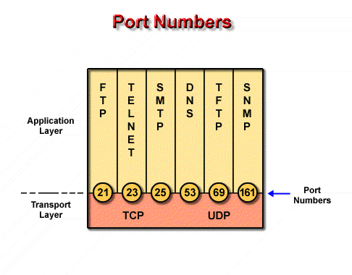
Service Model
Both TCP and UDP use port to keep track of different conversations that cross the network at the same time
Application software developers have agreed to use the well-known port numbers that are defined in RFC1700
Port numbers below 255 are reserved for TCP and UDP public applications.

Slide 7
Socket
Socket is presented as (IP_address, port)
Every connection is expressed as (socket_{source}, socket_{destination}), which is a point-to-point full-duplex channel
Does not support multicast and broadcast

Slide 8
Layer 4: The Transport Layer
An overview of layer 4
TCP (Transmission Control Protocol)
UDP(User Datagram Protocol)
An application: NAT and PAT

Slide 9
TCP Service Model
Problems must be solved in TCP:
Reliable transfer
Flow control
Sliding window
congestion avoidance…
Connection management
Establish connection：three handshakes
Release connection： four handshakes

Slide 10
位 0 8 16 24 31
源 端 口
目 的 端 口
序 号
20
字节
固定
首部
TCP
首部
确 认 号
数据
偏移
U
R
G
A
C
K
P
S
H
R
S
T
S
Y
N
F
I
N
保 留
窗 口
检 验 和
紧 急 指 针
选 项 （长 度 可 变）
填 充
源端口和目的端口字段——各占 2 字节
端口是运输层与应用层的服务接口
运输层的复用和分用功能都要通过端口才能实现

Slide 11
位 0 8 16 24 31
源 端 口
目 的 端 口
序 号
20
字节
固定
首部
TCP
首部
确 认 号
数据
偏移
U
R
G
A
C
K
P
S
H
R
S
T
S
Y
N
F
I
N
保 留
窗 口
检 验 和
紧 急 指 针
选 项 （长 度 可 变）
填 充
序号字段——占 4 字节
TCP 传送的数据流中的每一个字节都编上一个序号
序号字段的值指本报文段所发送的数据的第一个字节的序号

Slide 12
位 0 8 16 24 31
源 端 口
目 的 端 口
序 号
20
字节
固定
首部
TCP
首部
确 认 号
数据
偏移
U
R
G
A
C
K
P
S
H
R
S
T
S
Y
N
F
I
N
保 留
窗 口
检 验 和
紧 急 指 针
选 项 （长 度 可 变）
填 充
确认号字段——占 4 字节，是期望收到对方的下一个报文段的数据的第一个字节的序号

Slide 13
位 0 8 16 24 31
源 端 口
目 的 端 口
序 号
20
字节
固定
首部
TCP
首部
确 认 号
数据
偏移
U
R
G
A
C
K
P
S
H
R
S
T
S
Y
N
F
I
N
保 留
窗 口
检 验 和
紧 急 指 针
选 项 （长 度 可 变）
填 充
数据偏移（即首部长度）——占 4 位
指出 TCP 报文段的数据起始处距TCP 报文段的起始处的长度
单位是 32 位字（以 4 字节为计算单位）

Slide 14
位 0 8 16 24 31
源 端 口
目 的 端 口
序 号
20
字节
固定
首部
TCP
首部
确 认 号
数据
偏移
U
R
G
A
C
K
P
S
H
R
S
T
S
Y
N
F
I
N
保 留
窗 口
检 验 和
紧 急 指 针
选 项 （长 度 可 变）
填 充
保留字段——占 6 位，保留为今后使用，目前置 0

Slide 15
位 0 8 16 24 31
源 端 口
目 的 端 口
序 号
20
字节
固定
首部
TCP
首部
确 认 号
数据
偏移
U
R
G
A
C
K
P
S
H
R
S
T
S
Y
N
F
I
N
保 留
窗 口
检 验 和
紧 急 指 针
选 项 （长 度 可 变）
填 充
紧急 URG = 1 时，表明紧急指针字段有效
告诉系统此报文段中有紧急数据，应尽快传送(相当于高优先级的数据)

Slide 16
位 0 8 16 24 31
源 端 口
目 的 端 口
序 号
20
字节
固定
首部
TCP
首部
确 认 号
数据
偏移
U
R
G
A
C
K
P
S
H
R
S
T
S
Y
N
F
I
N
保 留
窗 口
检 验 和
紧 急 指 针
选 项 （长 度 可 变）
填 充
ACK = 1 时确认号字段有效
ACK = 0 时确认号字段无效

Slide 17
位 0 8 16 24 31
源 端 口
目 的 端 口
序 号
20
字节
固定
首部
TCP
首部
确 认 号
数据
偏移
U
R
G
A
C
K
P
S
H
R
S
T
S
Y
N
F
I
N
保 留
窗 口
检 验 和
紧 急 指 针
选 项 （长 度 可 变）
填 充
推送 PSH (PuSH) —— 接收 TCP 收到 PSH = 1 的报文段，就尽快地交付接收应用进程，而不再等到整个缓存都填满了后再向上交付

Slide 18
位 0 8 16 24 31
源 端 口
目 的 端 口
序 号
20
字节
固定
首部
TCP
首部
确 认 号
数据
偏移
U
R
G
A
C
K
P
S
H
R
S
T
S
Y
N
F
I
N
保 留
窗 口
检 验 和
紧 急 指 针
选 项 （长 度 可 变）
填 充
复位 RST (ReSeT= 1 时，表明 TCP 连接中出现严重差错（如由于主机崩溃或其他原因），必须释放连接，然后再重新建立运输连接

Slide 19
位 0 8 16 24 31
源 端 口
目 的 端 口
序 号
20
字节
固定
首部
TCP
首部
确 认 号
数据
偏移
U
R
G
A
C
K
P
S
H
R
S
T
S
Y
N
F
I
N
保 留
窗 口
检 验 和
紧 急 指 针
选 项 （长 度 可 变）
填 充
同步 SYN=1 表示这是一个连接请求或连接接受报文

Slide 20
位 0 8 16 24 31
源 端 口
目 的 端 口
序 号
20
字节
固定
首部
TCP
首部
确 认 号
数据
偏移
U
R
G
A
C
K
P
S
H
R
S
T
S
Y
N
F
I
N
保 留
窗 口
检 验 和
紧 急 指 针
选 项 （长 度 可 变）
填 充
终止 FIN (FINis) —— 用来释放一个连接。FIN = 1 表明此报文段的发送端的数据已发送完毕，并要求释放运输连接。

Slide 21
窗口字段 —— 占 2 字节，用来让对方设置发送窗口的依据，单位为字节。
位 0 8 16 24 31
源 端 口
目 的 端 口
序 号
20
字节
固定
首部
TCP
首部
确 认 号
数据
偏移
U
R
G
A
C
K
P
S
H
R
S
T
S
Y
N
F
I
N
保 留
窗 口
检 验 和
紧 急 指 针
选 项 （长 度 可 变）
填 充

Slide 22
位 0 8 16 24 31
源 端 口
目 的 端 口
序 号
20
字节
固定
首部
TCP
首部
确 认 号
数据
偏移
U
R
G
A
C
K
P
S
H
R
S
T
S
Y
N
F
I
N
保 留
窗 口
检 验 和
紧 急 指 针
选 项 （长 度 可 变）
填 充
检验和 —— 占 2 字节。检验和字段检验的范围包括首部和数据这两部分

Slide 23
位 0 8 16 24 31
源 端 口
目 的 端 口
序 号
20
字节
固定
首部
TCP
首部
确 认 号
数据
偏移
U
R
G
A
C
K
P
S
H
R
S
T
S
Y
N
F
I
N
保 留
窗 口
检 验 和
紧 急 指 针
选 项 （长 度 可 变）
填 充
紧急指针字段 —— 占 16 位，指出在本报文段中紧急数据共有多少个字节（紧急数据放在本报文段数据的最前面）

Slide 24
比特 0 8 16 24 31
源 端 口
目 的 端 口
。
序 号
20
字节
固定
首部
TCP
首部
确 认 号
数据
偏移
U
R
G
A
C
K
P
S
H
R
S
T
S
Y
N
F
I
N
保 留
窗 口
检 验 和
紧 急 指 针
选 项 （长 度 可 变）
填 充
TCP 最初只有一种选项，即最大报文段长度 MSS(Maximum Segment Size)
MSS 告诉对方缓存所能接收的报文段的数据字段的最大长度是 MSS 个字节
数据字段加上 TCP 首部才等于整个的 TCP 报文段

Slide 25
位 0 8 16 24 31
源 端 口
目 的 端 口
序 号
20
字节
固定
首部
TCP
首部
确 认 号
数据
偏移
U
R
G
A
C
K
P
S
H
R
S
T
S
Y
N
F
I
N
保 留
窗 口
检 验 和
紧 急 指 针
选 项 （长 度 可 变）
填 充
填充字段 —— 这是为了使整个首部长度是 4 字节的整数倍。

Slide 26
TCP Protocol
Hosts exchange data by using segment(TPDU)
Each segment has:
a header of 20 bytes(except optional parts)
0 or more data bytes
The size of the segment must be matched with IP packets, and also must satisfy the demand of bottom layers
For example, the MTU(Maximal Transfer Unit) of Ethernet is 1500 bytes
Each byte has a 32 bits sequence number

Slide 27
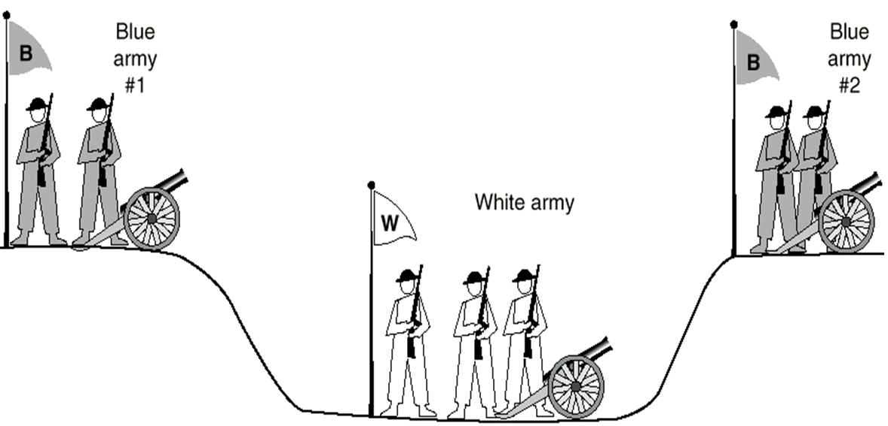
Reliable Connection?
Two-army Problem

Slide 28
TCP: Establish Connection
Client
Server
A
B
Active open
Closed
Closed
Passive
open
SYN = 1, seq = x
The First Handshake
Server: executes LISTEN and ACCEPT primitive, and monitors passively
Client: executes CONNECT primitive, generate a TCP segment with SYN=1 and ACK=0,which stands for connection request

Slide 29
TCP: Establish Connection
Client
Server
A
B
Active open
Closed
Closed
Passive
open
SYN = 1, seq = x
SYN = 1, ACK = 1, seq = y, ack= x + 1
The Second Handshake
Server checks if exists service process monitoring the port
If none process, answer a TCP segment with RST=1
If exists process, decides to reject or to accept the request
If accept the connection request, send a segment with SYN=1 and ACK=1

Slide 30
TCP: Establish Connection
Client
Server
A
B
Active open
Closed
Closed
Passive
open
SYN = 1, seq = x
SYN = 1, ACK = 1, seq = y, ack= x + 1
ACK = 1, seq = x + 1, ack = y + 1
The Third Handshake
The client sends a segment with SYN=0 and ACK=1 to acknowledge the connection

Slide 31
TCP: Establish Connection
Client
Server
A
B
Active open
Closed
Closed
Passive
open
SYN = 1, seq = x
SYN = 1, ACK = 1, seq = y, ack= x + 1
ACK = 1, seq = x + 1, ack = y + 1
Data Transfer
When the server receives the acknowledgement, it informs the upper layer applications

Slide 32
TCP: Establish Connection
Client
Server
A
B
Active open
Closed
Closed
Passive
open
SYN = 1, seq = x
LISTEN
SYN-
SENT
SYN = 1, ACK = 1, seq = y, ack= x + 1
SYN-
RCVD
ACK = 1, seq = x + 1, ack = y + 1
ESTAB-
LISHED
Data Transfer
ESTAB-
LISHED

Slide 33
Example: Establish Connection
TCP A TCP B
1. CLOSED LISTEN
2. SYN-SENT --> <SEQ=100><CTL=SYN> --> SYN-RECEIVED
3. ESTABLISHED <-- <SEQ=300><ACK=101><CTL=SYN,ACK> <-- SYN-RECEIVED
4. ESTABLISHED --> <SEQ=101><ACK=301><CTL=ACK> --> ESTABLISHED
5. ESTABLISHED --> <SEQ=101><ACK=301><CTL=ACK><DATA> --> ESTABLISHED
Basic 3-Way Handshake for Connection Synchronization
Note that the ACK does not occupy sequence number space (if it did, we would wind up ACKing ACK's!)

Slide 34
Data transfer ——stop-and-wait protocol
A
B
A
B
Send M₁
Send M₁
ACK M₁

Dispose
the segment
Send M₂
Resend M₁
ACK M₂
ACK M₁
Send M₃
Send M₂
ACK M₃
t
t
t
t
(a) No error
(b) Out of time

Slide 35
Data transfer ——stop-and-wait protocol
After sending a segment, preserve a backup temporarily
Each segment and ACK must have ID
The resend-time must be more than average-travel-time *2
stop-and-wait protocol is a simple protocol, but has poor efficiency

Slide 36
Data transfer ——Lost ACK and Late ACK
A
B
A
B
Send M₁
Send M₁

ACK M₁

ACK M₁
Out of time
Resend M₁
Out of time
Resend M₁
Dispose the repeated M₁ and resend ACK_{M2}
Dispose the repeated M₁ and resend ACK_{M1}
Send M₂
Send M₂
Receive the
late ACK and
do nothing
t
t
t
t
(a) Lost ACK
(b) Late ACK

Slide 37
Reliable Communication
ARQ (Automatic Repeat reQuest)。
It means the ‘resend request’ is automatically sent and the receiver need not request the sender to resend the error segment

Slide 38
Contiguous ARQ Protocol
t
ACK
Segment
t
发送窗口
1
2
3
4
5
6
7
8
9
10
11
12
(a) 发送方维持发送窗口（发送窗口是 5）
发送窗口
向前
1
2
3
4
5
6
7
8
9
10
11
12
(b) 收到一个确认后发送窗口向前滑动

Slide 39
TCP: Release Connection
Client
Server
A
B
Active Close
ESTAB-
LISHED
ESTAB-
LISHED
Data Transfer
Passive
Close
FIN = 1, seq = u
CLOSED

Slide 40
TCP: Release Connection
Client
Server
A
B
Inform Upper Layer
Active Close
ESTAB-
LISHED
ESTAB-
LISHED
Data Transfer
FIN = 1, seq = u
ACK = 1, seq = v, ack= u + 1

Slide 41
TCP: Release Connection
Client
Server
A
B
Inform Upper Layer
Active Close
ESTAB-
LISHED
ESTAB-
LISHED
Data Transfer
FIN = 1, seq = u
ACK = 1, seq = v, ack= u + 1
Passive
Close
Data Transfer
FIN = 1, ACK = 1, seq = w, ack= u + 1

Slide 42
TCP: Release Connection
Client
Server
A
B
Inform Upper Layer
Active Close
ESTAB-
LISHED
ESTAB-
LISHED
Data Transfer
FIN = 1, seq = u
ACK = 1, seq = v, ack= u + 1
Passive
Close
Data Transfer
FIN = 1, ACK = 1, seq = w, ack= u + 1
ACK = 1, seq = u + 1, ack = w + 1

Slide 43
TCP: Release Connection
Client
Server
A
B
Inform Upper Layer
Active Close
ESTAB-
LISHED
ESTAB-
LISHED
Data Transfer
FIN = 1, seq = u
FIN-
WAIT-1
ACK = 1, seq = v, ack= u + 1
CLOSE-
WAIT
Passive
Close
Data Transfer
FIN-
WAIT-2
FIN = 1, ACK = 1, seq = w, ack= u + 1
LAST-
ACK
Wait 2MSL
ACK = 1, seq = u + 1, ack = w + 1

TIME-
WAIT
Before releasing connection, the client must wait for 2MSL
CLOSED
CLOSED

Slide 44
Why must wait for 2MSL?
To ensure the last ACK sent by A can reach B
To prevent any invalid connection request segment from emerging
After waiting for 2MSL , we can make sure that all segments on the connection have disappeared

Slide 45
T C P 的 有 限 状 态 机
起点
CLOSED
被动打开
主动打开
发送 SYN
关闭
收到 SYN
发送 SYN, ACK
LISTEN
被动打开
收到 RST
发送 SYN
关闭
或超时
SYN_RCVD
收到 SYN，发送 SYN, ACK
SYN_SENT
同时打开
主动打开
收到 ACK
收到 SYN, ACK
发送 ACK
关闭
发送 FIN
数据传送
阶段
收到 FIN
发送 ACK
被动关闭
ESTABLISHED
CLOSE_WAIT
关闭
发送 FIN
主动关闭
关闭
发送 FIN
收到 FIN
发送 ACK
同时关闭
FIN_WAIT_1
CLOSING
收到 ACK
收到 FIN, ACK
发送 ACK
LAST_ACK
收到 ACK
收到 ACK
收到 FIN
发送 ACK
FIN_WAIT_2
TIME_WAIT
定时经过两倍报文段寿命后

Slide 46
Layer 4: The Transport Layer
An Overview of Layer 4
TCP (Transmission Control Protocol)
UDP(User Datagram Protocol)
An application: NAT and PAT

Slide 47
UDP (User Datagram Protocol)
Why do we need UDP?
No connection establishment (which can add delay)
Simple: no connection state at sender, receiver
Small segment header
No congestion control: UDP can blast away as fast as desired

Slide 48
UDP (User Datagram Protocol)
Connectionless:
no handshaking between UDP sender, receiver
each UDP segment handled independently of others
Often used for streaming multimedia applications
loss tolerant
rate sensitive
UDP are used in:
RIP: To send the route information periodically
DNS: Avoid the delay to setup the TCP connection
SNMP: When congestion, SNMP must still runable. Without the congestion and reliability control mechanism, UDP has better performance than TCP under the circumstances.
Other protocols include TFTP, DHCP
Add reliability at application layer if necessary

Slide 49
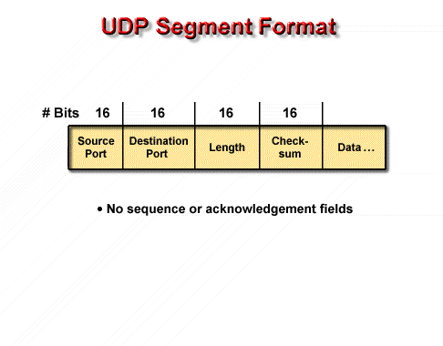
UDP (User Datagram Protocol)

Slide 50
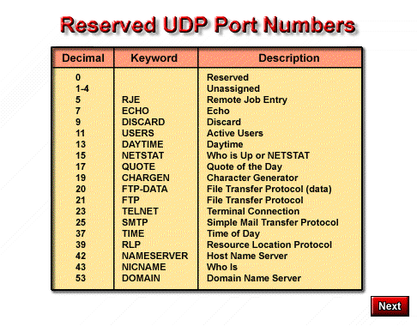

Slide 51
Layer 4: The Transport Layer
An Overview of Layer 4
TCP (Transmission Control Protocol)
UDP(User Datagram Protocol)
An application: NAT and PAT

Slide 52
What is NAT?
NAT, is the process of swapping one address for another in the IP packet header
In practice, NAT is used to allow hosts that are privately addressed to access the Internet
One of solutions to IP address depletion
Conserves registered (legal) addresses
Increases Flexibility when connecting to Internet
RFC 1631 - Network Address Translator (NAT)
Notes:
Because many private networks exist alongside public nets, grabbing "just any address" is strongly discouraged. RFC 1918 sets aside three blocks of IP addresses (i.e., a Class A, a Class B, and a Class C range) for private, internal use. Addresses in this range will not be routed on the Internet backbone . Internet routers immediately discard private addresses. When using private addresses on a network that is connected to the Internet, you should filter packets and routing updates to avoid "leaking" any RFC 1918 addresses between autonomous systems. For example, if both you and your provider use addresses from the 192.168.0.0 /16 block, your routers could get confused if confronted with updates from both systems.
NAT is the process of swapping one address for another in the IP packet header. In practice, NAT is used to allow hosts that are privately addressed (using RFC 1918 addresses) to access the Internet.
When a host inside the private domain wants to transmit to a host on the outside world, it forwards the packet to the NAT-enabled device. The NAT process then looks inside the IP header and, if appropriate, replaces the inside IP address with a globally unique IP address. When an outside host sends a response, the NAT process receives it, checks the current table of network address translations, and replaces the destination address with the original inside source. NAT translations can occur dynamically or statically and can be used for a variety of purposes. The most powerful feature of NAT routers is their capability to use port address translation (PAT), which allows multiple inside addresses to map to the same global address. This is sometimes called a "many-to-one" NAT. This procedure allows for many user inside of the private network to share one single external IP address. When using PAT the NAT router keeps track of the different conversations by mapping TCP and UDP port numbers.

Slide 53
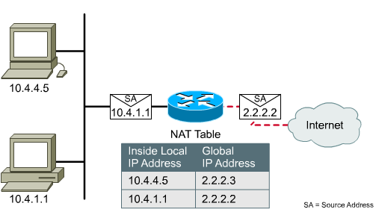
NAT a simple concept
Registered addresses
Private addresses

Slide 54
NAT types
Static NAT:
Fixed mapping of an internal address to an registered address
Dynamic NAT:
Mapping is done dynamically on a first come first served basis
PAT (Overload):
Port address translation is used to allow many internal users to share a single ‘inside global’ address

Slide 55
NAT address types
Inside Local address (内部本地地址 ):内网IP地址
Inside Global address (内部全局地址): 注册IP地址,对外部展示的内部地址
Outside Global address (外部全局地址):由主机所有者分配的IP地址。通常是注册地址。

Slide 56
NAT address types
Inside
Outside
4
Inside Global
addresses
DA
198.168.2.1
5
Host B
10.1.1.3
3
172.80.7.3
DA
10.1.1.1
SA
198.168.2.1
Internet
10.1.1.2
Host C
1
172.81.7.3
2
NAT table
Outside Global addresses
SA
10.1.1.1
Inside Local IP
Inside Global IP
Outside Global
Address
Address
IP Address
10.1.1.1
10.1.1.3
198.168.2.3
172.81.7.3
Host A
10.1.1.2
198.168.2.2
172.81.7.3
Inside Local addresses
10.1.1.1
198.168.2.1
172.80.7.3

Slide 57


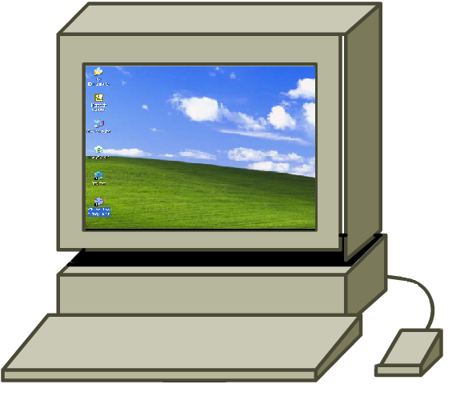
Static: How does it work?
Inside
Outside
S0/0
E0/0
10.1.1.2
Static
Translation Table
10.1.1.2 = 203.10.10.2 10.1.1.3 = 203.10.10.3 10.1.1.4 = 203.10.10.4
10.1.1.3
10.1.1.4

Slide 58
Dynamic:How does it work?
Inside
Outside
E0/0
S0/0
10.1.1.2
Dynamic
Translation Table
10.1.1.4 = 203.10.10.2 10.1.1.2 = 203.10.10.3 10.1.1.3 = 203.10.10.4
10.1.1.3
10.1.1.4
Notes:
access-list 2 permit 10.1.1.0 0.0.0.255

Slide 59
Advantages and Disadvantages of NAT
Advantage: since not every inside host needs outside access at the same time, you can get away with using a small pool of globally unique addresses to serve a relatively large number of privately addressed hosts.
Disadvantage: one-to-one mapping.
That is, if the private address space is a /8, but the public address is a /24, only 254 hosts can access the Internet at a time.

Slide 60
PAT: How does it work?
Inside
Outside
S0/0
E0/0
10.1.1.2
Port Translation Table
Inside Local IP SRC Port DST Port Inside Global IP
10.1.1.3
10.1.1.4 1024 80 203.10.10.2
10.1.1.2 1122 80 203.10.10.2
10.1.1.3 1343 80 203.10.10.2
10.1.1.4
Notes:
access-list 2 permit 10.1.1.0 0.0.0.255
ip nat inside source list 101 interface dialer1 overload
access-list 101 permit ip 10.0.0.0 0.255.255.255 any

Slide 61
PAT Operation
Inside
Most common situation for small Networks.
4
DA
198.168.2.2
5
Host B
10.1.1.3
3
172.80.7.3
DA
10.1.1.1
SA
198.168.2.2
4
Internet
DA
198.168.2.2
10.1.1.2
Host C
1
2
NAT table
172.81.7.3
SA
10.1.1.1
Protocol
Inside Local IP
Inside Global IP
Outside Global
Address: Port
Address: Port
IP Address: Port
10.1.1.1
TCP
10.1.1.3:1723
198.168.2.2:1492
172.81.7.3:23
Host A
TCP
10.1.1.2:1723
198.168.2.2:1723
172.81.7.3:23
TCP
10.1.1.1:1024
198.168.2.2:1024
172.80.7.3:23

Slide 62


谢 谢！

